Slide 1

Organizational conflict

Slide 2

Concept of organizational conflict
Organizational conflict is a natural aspect of organizational life that arises due to differences in goals, values, or perspectives among members.
Understanding its sources, dynamics, and potential impacts is crucial for effectively managing conflict and leveraging it as a catalyst for organizational growth and development.

Slide 3
Managing Team Conflict
Managing team conflict
Stimulating Task Related Conflict
Minimizing Relationship Conflict
Managing Inter Personal Conflicts

Slide 4
Stimulating task-related conflict
Encourage Diverse Perspectives: Bring together team members with different backgrounds, expertise, and viewpoints.
Assign Ambiguous Tasks: Give team members tasks or projects with open-ended goals or vague guidelines.
Promote Devil's Advocacy: Encourage team members to play the role of devil's advocate during discussions and decision-making processes. This means deliberately challenging ideas and proposals to uncover potential flaws and stimulate constructive debate.
Use Competing Goals: Introduce conflicting goals or priorities within a project or task. For example, one goal might prioritize speed while another prioritizes quality.

Slide 5
Minimizing Relationship Conflict
Establish Clear Communication Channels: Ensure that there are open and transparent communication channels within the team or organization.
Promote Active Listening: Train team members in active listening techniques, such as paraphrasing and summarizing, to improve communication.
Clarify Roles and Responsibilities: Clearly define each team member's roles, responsibilities to minimize conflicts from misunderstandings.
Encourage Empathy and Respect: Encourage team members to consider others' perspectives and feelings before responding or taking action.

Slide 6
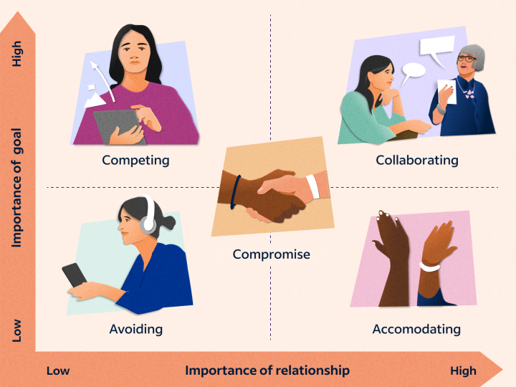
Managing Inter Personal Conflicts

Slide 7




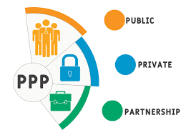

Position of teamwork in Nepalese organization
1. Sport sector
2. Government sector
3. Private sector
4. Army/Police
5. Public private partnership
6. Public enterprises

